Slide 1
Making life better
Basic 12 Lesson A

Slide 2
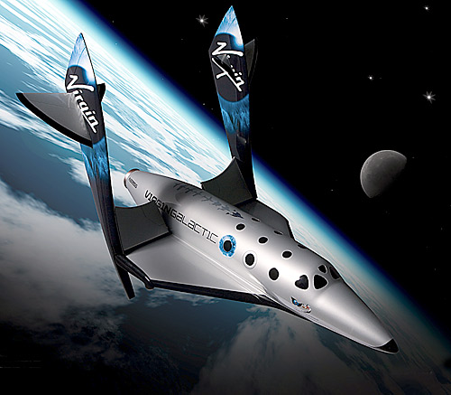

Slide 3
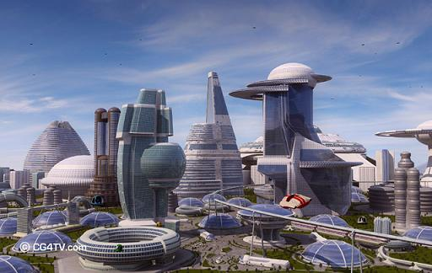

Slide 4
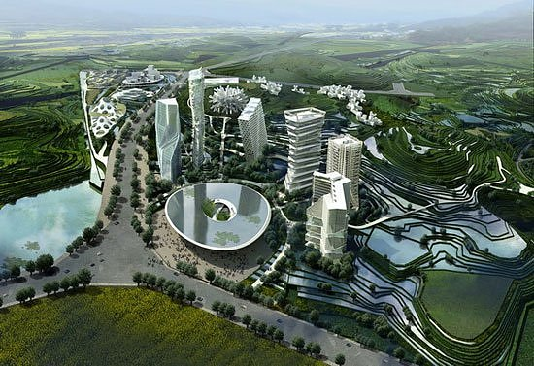

Slide 5
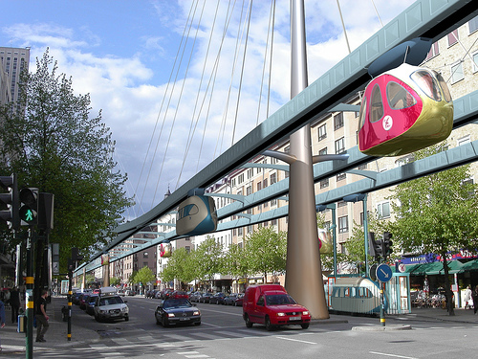

Slide 6
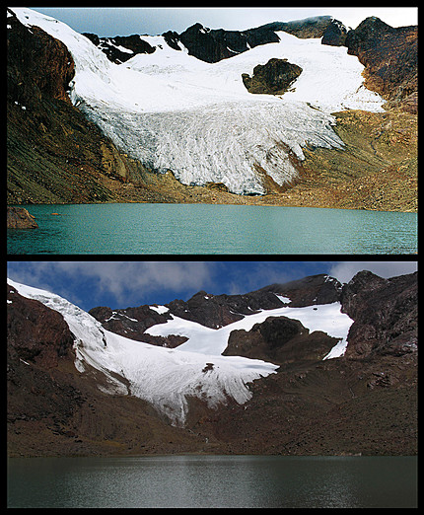

Slide 7
http://www.youtube.com/watch?v=1qT-rOXB6NI
Good morning america : http://www.youtube.com/watch?v=WtewmJ78hzw
Short documentary: http://www.youtube.com/results?search_query=the+great+pacific+garbage+patch&sm=3

